Slide 1
The Science Behind Cleaner Air

Slide 2
Monitoring Particulate Air Pollution
Many developing countries do not have air monitoring sensors, so it is difficult to estimate the amount of pollution
Particle pollution is one-tenth the diameter of a human hair (PM_{2.5} = 2.5 micrometers or less in diameter)
Suspected of contributing to millions of premature deaths around the world each year

Slide 3
Health Impacts
Fine particulate matter can enter the lungs and then the bloodstream
Causes asthma, cardiovascular disease, bronchitis
The American Heart Association estimates that PM_{2.5} contributes to 60,000 deaths a year in the U.S.

Slide 4
Satellites Offer a Global Perspective
Problem: most satellite instruments cannot tell the difference between particles that are close to the ground and those high in the atmosphere
Canadian researchers Donkelaar & Martin used data from two NASA satellite instruments and a computer modeling program to develop a new map

Slide 5
NASA’s Scientific Instruments
Multi-angle Imaging Spectroradiometer (MISR)
Photo Credit: NASA/CalTech/JPL

Slide 6
NASA’s Scientific Instruments
Moderate Resolution Imaging Spectroradiometer (MODIS)
Photo Credit: NASA/GSFC

Slide 7
The New Map
Provides an estimate of PM_{2.5} pollution over developing countries, something that has been hard to do in the past
When compared with maps of population density, the new map suggests that more than 80% of the world’s population breathes air that exceeds the World Health Organization’s limits on air particulates

Slide 8
Global Satellite-Derived Map of Particulates Over 2001-2006
Credit: Dalhousie University, Aaron van Donkelaar

Slide 9
Where do you see the highest concentrations of PM_{2.5}?
Saudi Arabia (Middle East)
Niger, Chad, Mali, Western Sahara (Africa)
Eastern China
Northern India

Slide 10
Why are particulate emissions higher in these areas?
Hint #1: particulates come from both natural and man-made sources
Hint #2: particulates come from coal-fired power plants and factories
Hint #3: particulates come from vehicle exhaust
Hint #4: particulates come from burning of fields
Hint #5: wind blows dust from roads and deserts into the air

Slide 11
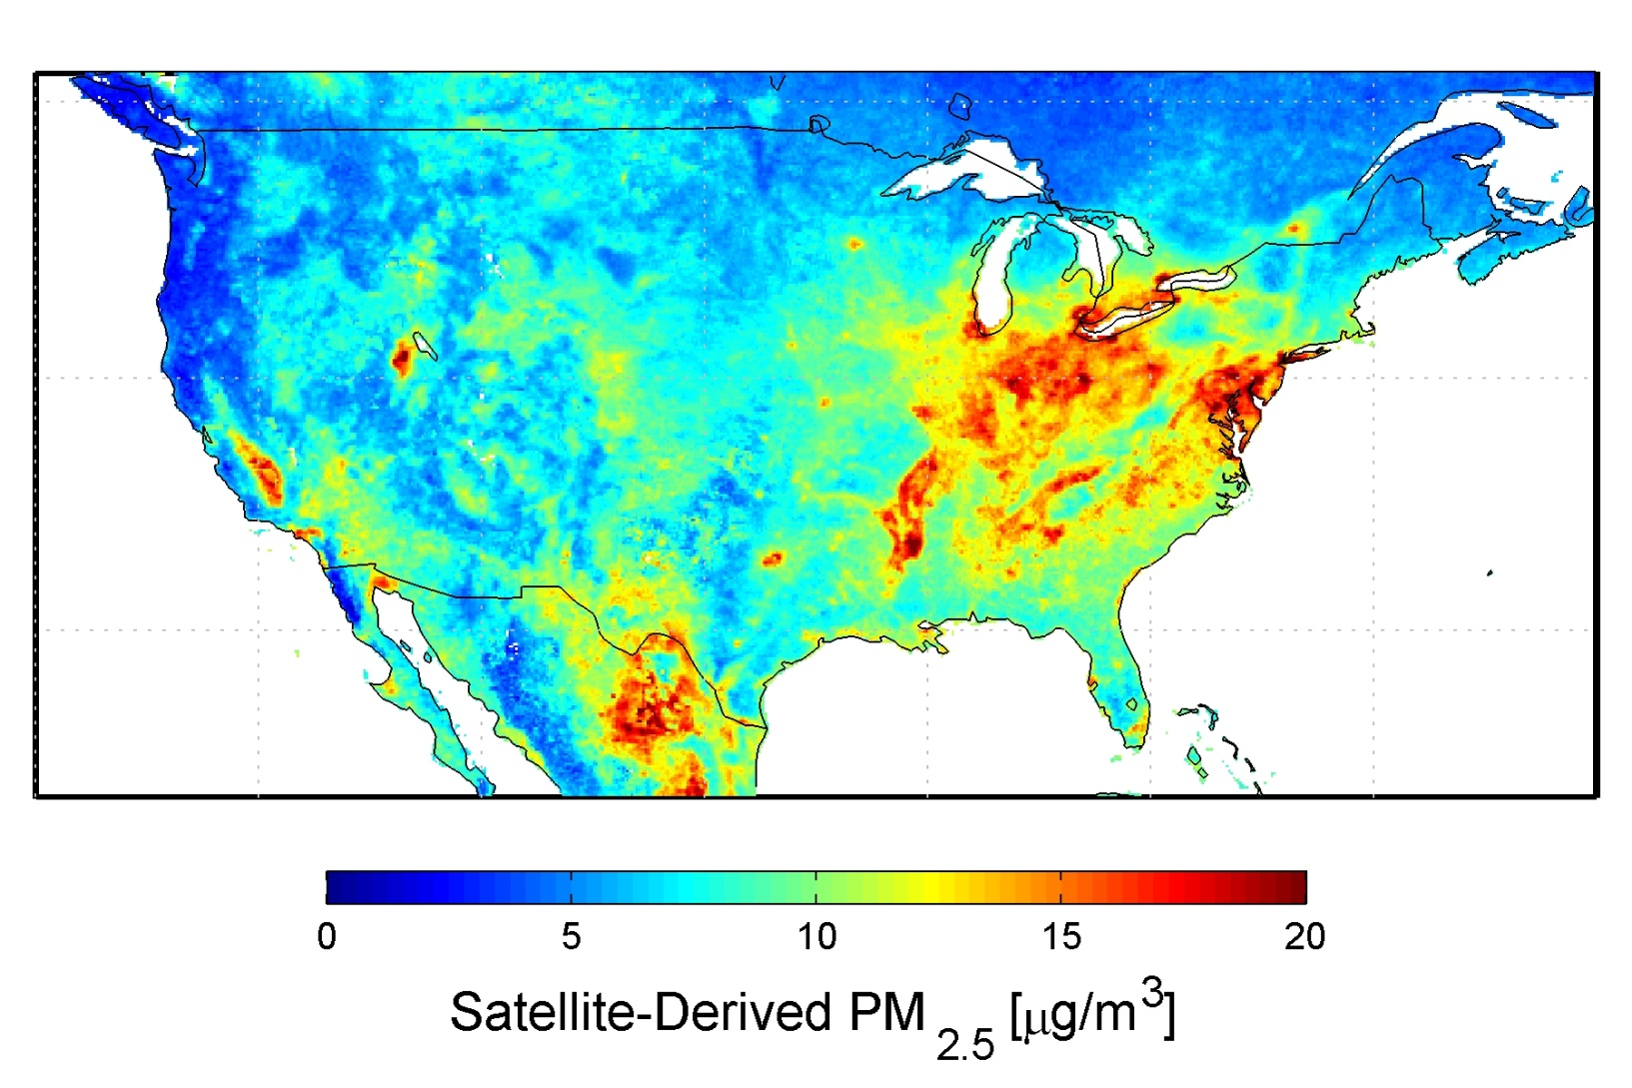
What’s going on in North America?

Slide 12
Resources
“New Map Offers a Global View of Health-Sapping Air Pollution,” Adam Volland, Sept. 22, 2010, NASA’s Earth Science News Team http://www.nasa.gov/topics/earth/features/health-sapping.html

